Slide 1

DESIGN ACTIVITY
Sergi Albiach, Anna Garriga, Benet Manzanares and Ramon Mateo

Slide 2
Index
Introduction
Agent Description
System Architecture

Slide 3
Introduction

Slide 4
Introduction
Collaborative classificator for firm fraud detection
AUDIT dataset - 767 instances - 25 characteristics
Train 10 classifiers
Coordinate them to obtain unique test predictions

Slide 5
Agent Description

Slide 6
User Agent
Role: It is in charge of loading the dataset, splitting the data into training and test, starting the training and managing user queries. Its communication is limited to the coordination agent.
Number of agents: 1

Slide 7
User Agent: properties, functions, messages
Properties:
Social ability
Rationality
Messages:
train_agents
test_agents
Functions:
prepare_data

Slide 8
Classifier Agent
Role/s: It receives a part of the training data and creates a Decision Tree based on it. It also receives test cases and sends the output classification result to the coordinator agent.
Number of agents: 10

Slide 9
Classifier Agent: properties, functions and messages
Properties:
Social Ability
Rationality
Learning
Reasoning Capabilities
Social ability
Rationality
Learning
Reasoning capabilities
Messages:
end_training
end_prediction
Functions:
train_tree
predict

Slide 10
Coordinator Agent
Role/s: It is responsible for receiving the output classifications from the classifier agents and elaborating the final classification output by weighting the options using the validation step accuracy. This result will be sent to the user
Number of agents: 1

Slide 11
Coordinator Agent: properties, functions and messages
Properties:
Social ability
Rationality
Reasoning capabilities
Social ability
Rationality
Reasoning capabilities
Messages:
end
train
predict
Function:
assign_attributes
split_data
compute_accuracy

Slide 12
System Architecture

Slide 13
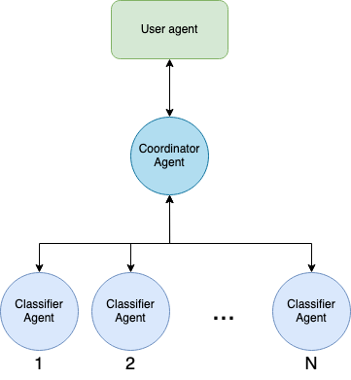
General Architecture

Slide 14
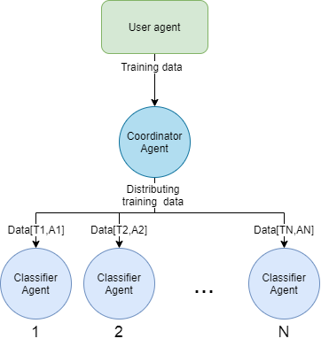
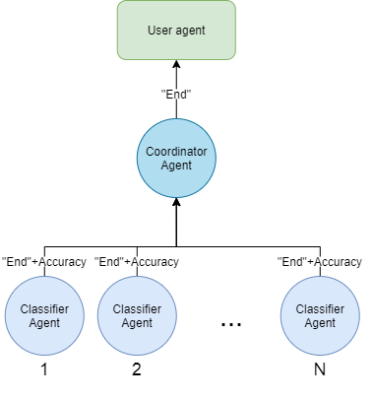
Training architecture

Slide 15
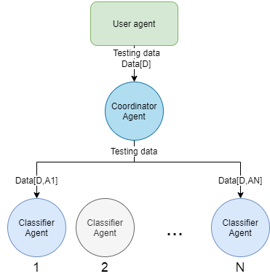
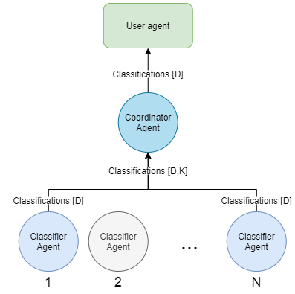
Test Data and final classification

Slide 16
DESIGN ACTIVITY
Sergi Albiach, Anna Garriga, Benet Manzanares and Ramon Mateo

